Slide 1


Rutu Mulkar-Mehta • Data Scientist @rutumulkar • me@rutumulkar.com http://rutumulkar.com
A tutorial on
Using Python
FOR Linguistic Data Analysis

Slide 2
Who Am I?
Data Scientist at Moz
Background:
PhD in Natural Language Processing
Computer Science: BS, MS, PhD
Worked on:
IBM Watson
NLP in Healthcare
NLP for SEO (Search Engine Optimization)
Other Stuff: Sentiment Analysis, Question Answering, Natural Language Understanding ++

Slide 3

Goals
Highly interactive
Stop me to ask questions
No question is silly

Slide 4
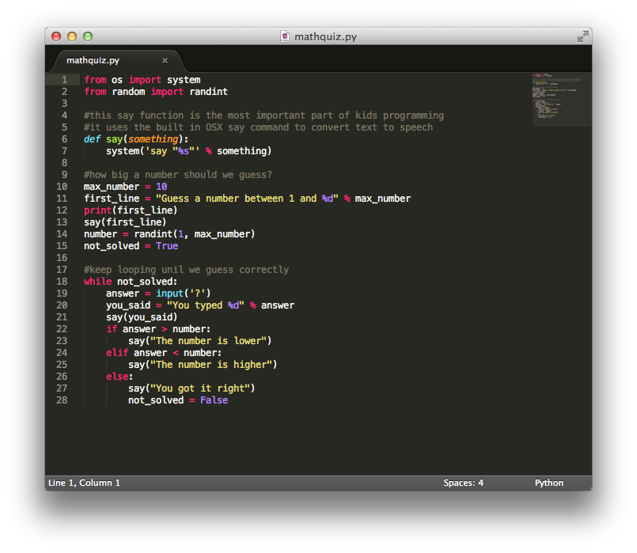
Goals
Code as you go
The end goal is for YOU to learn

Slide 5
Tools to Install
Python Installation:
https://www.python.org/downloads/
iPython installation
http://ipython.org/install.html
(sudo) pip install ipython
Fork/Download this Repo:
https://github.com/rutum/pynlp

Slide 6
Handy Python Tools
Requests:
sudo pip install requests
BeautifulSoup:
sudo pip install beautifulsoup4
Gensim:
sudo pip install gensim

Slide 7

Quick Poll
Familiarity with python?
Quick Poll

Slide 8
Quick Poll
Familiarity with python?
Familiarity with NLP?
Quick Poll

Slide 9
Quick Poll
Familiarity with python?
Familiarity with NLP?
Familiarity with Machine Learning?
Quick Poll

Slide 10
Quick Poll
Familiarity with python?
Familiarity with NLP?
Familiarity with Machine Learning?
What do you want to do with NLP?
Quick Poll

Slide 11
Some Areas of NLP
An Introduction

Slide 12
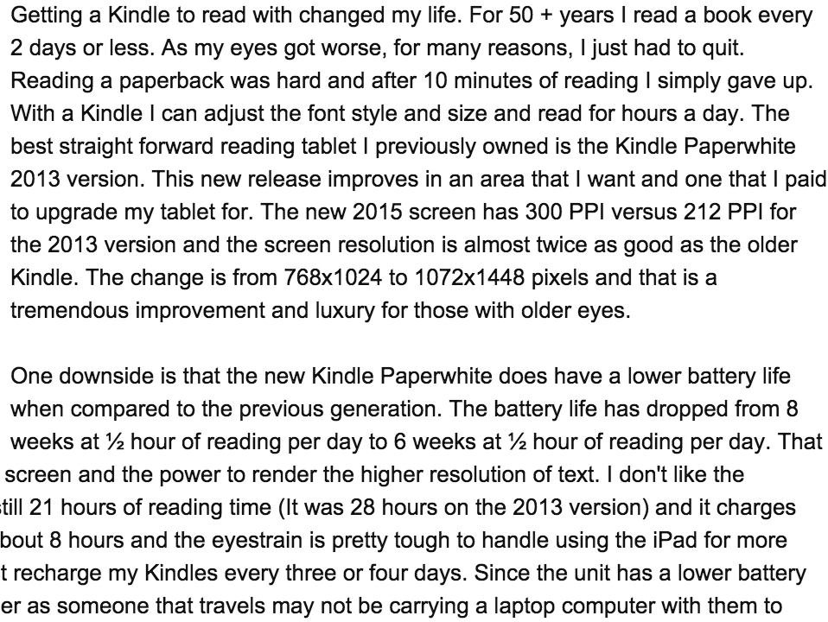


Sentiment Analysis
Product Reviews – Kindle Paperwhite
v
Sharp
screen resolution
Low
battery life

Slide 13
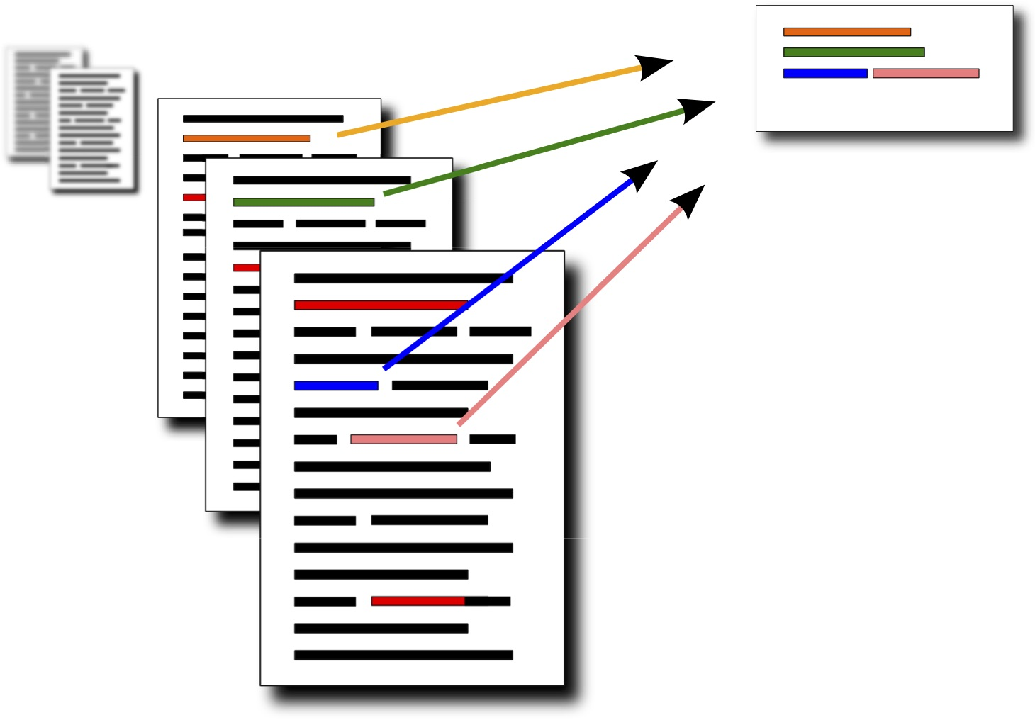
Text Summarization

Slide 14
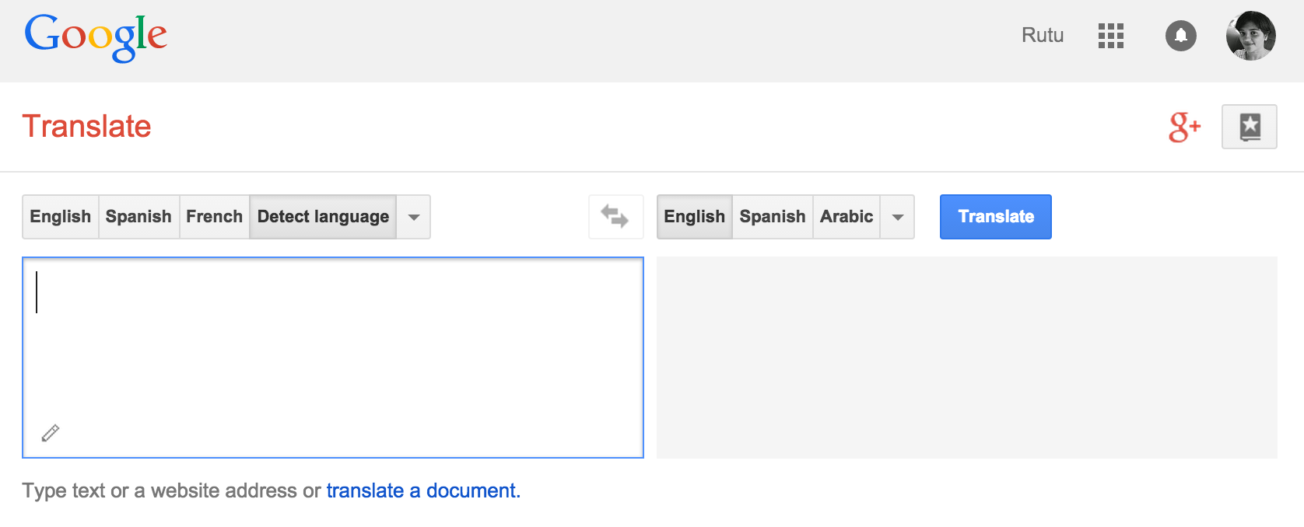
Machine Translation

Slide 15
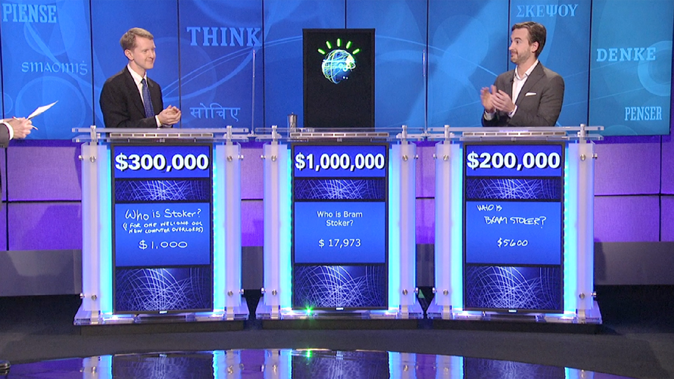
Question Answering
In 2011, Watson competed on Jeopardy! To be the first computer to defeat two humans on the game show.

Slide 16
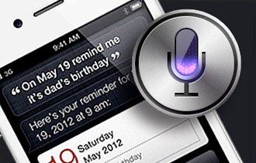
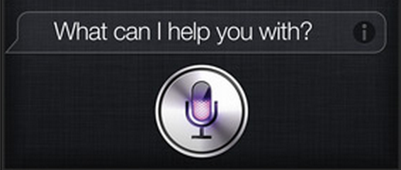
SIRI
Information Extraction
Topic Modeling
Question Answering
Text Classification
Named Entity Recognition
….

Slide 17
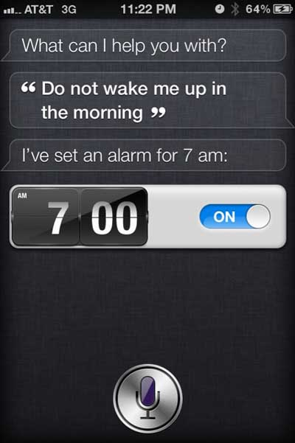
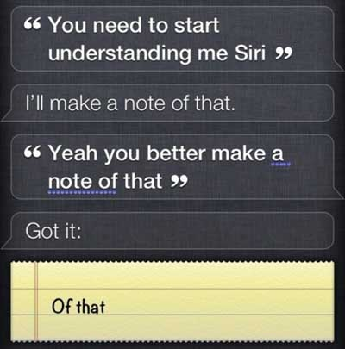

Slide 18
Talk Overview
Topics we will Be Covering Today

Slide 19
Outline
Information Extraction: Extract “stuff” from unstructured text
Information Retrieval: search from several documents
Deep Learning: Converting words to semantic vectors
Peppered with some NLP “Folk Knowledge”, hence forth known as “Fairy Godmother”

Slide 20

Congratulations!!
You have just been offered a job at an innovative new startup in Seattle called “New Tech Stories Inc.”
You have accepted the position!
You are going to be working with linguistic data!

Slide 21

Welcome aboard!
… here, analyze this data ...

Slide 22
Data Analysis
Github repo: https://github.com/rutum/pynlp
Go to the folder “data collection”:
data_file.txt
77 Talks at pyData Seattle 2015

Slide 23
We want to know…
What are people talking about?

Slide 24
We want to know…
What are people talking about?
What is the trend in python and data science these days in Seattle?

Slide 25
We want to know…
What are people talking about?
What is the trend in python and data science these days in Seattle?

Slide 26
FAIRY GODMOTHER SAYS
ALWAYS KNOW HOW TO EVALUATE YOUR DATA

Slide 27
FAIRY GODMOTHER SAYS
ALWAYS KNOW HOW TO EVALUATE YOUR DATA
What should we expect to find?
If you know what to expect, you can inspect your results periodically and check if you are in line with your expectations

Slide 28
FAIRY GODMOTHER SAYS
ALWAYS KNOW HOW TO EVALUATE YOUR DATA
What should we expect to find?
If you know what to expect, you can inspect your results periodically and check if you are in line with your expectations
How should we get there?
What are the patterns that you see in your expected results e.g.
Are all your expected “keywords” also keynote presentations?
Are all your expected “keywords” all scheduled in room 1?

Slide 29
What should we expect to see
Suggestions?
data
python
machine learning
nlp analysis
tutorials
microsoft
anaconda
code
Audience Participation

Slide 30
Where do we start?
Suggestions?
frequency
TF IDF ->
LSI
Word2Vec
categories
Audience Participation

Slide 31
Experiments we will do
Word Frequencies
TF*IDF : word importance
Focus on Noun Phrases only?

Slide 32
Word Frequencies
Also known as TF – Term Frequency
Most frequent concepts are trending concepts
Functions:
nlp_tools.word_count(text, <wc_dict>)
nlp_tools.information_extraction(<filename>)

Slide 33
Findings
Suggestions?
Audience Participation

Slide 34
What Next?
Frequencies alone are not enough. Words like “a”, “the” are the most common ones, but have the least impact
Maybe we can remove stop words?

Slide 35
What Are Stop Words
Extremely frequent words that don’t add any semantic value to the text

Slide 36
What Are Stop Words
Extremely frequent words that don’t add any semantic value to the text
Stop words are different for different domains, based on what the text is about

Slide 37
What Are Stop Words
Extremely frequent words that don’t add any semantic value to the text
Stop words are different for different domains, based on what the text is about
Usually hand curated, based on the type of data we are looking at. E.g. In pyData related talks – python and data are stopwords

Slide 38
Experiments Removing Stop Words
StopWords file:
stopwords.txt
Load Stopwords:
nlp_tools.load_stopwords(<filename>)
stopwords = load_stopwords(<filename>)
Check if token is stopword:
nlp_tools.is_stopword(token)

Slide 39
Findings
Suggestions?
Audience Participation

Slide 40
Next Steps
We need a ratio of uncommon words, that are just frequent enough

Slide 41
Next Steps
We need a ratio of uncommon words, that are just frequent enough
Lets use TF*IDF

Slide 42
TF*IDF Basics
Raw term frequency suffers from a critical problem: all terms are considered equally important

Slide 43
TF*IDF Basics
Raw term frequency suffers from a critical problem: all terms are considered equally important
Intuitive example : word “a” – high frequency, but occurs in all documents

Slide 44
TF*IDF Basics
Raw term frequency suffers from a critical problem: all terms are considered equally important
Intuitive example : word “a” – high frequency, but occurs in all documents
Scale down the term weights by the number of documents they occur in – DF (Document Frequency)

Slide 45
IDF : Inverse Document Frequency
How is the document frequency DF of a term used to scale its weight?
N = total number of documents
t = current word or token
IDF_{t} = log (N/DF_{t})

Slide 46
TF*IDF Formula
TF = Term Frequency
IDF = Inverse Document Frequency (Inverse of the Document Frequency)
TF_{t} * IDF_{t} = TF_{t} * log (N/DF_{t})

Slide 47
Experiments with TF IDF
Using TF*IDF
Function:
nlp_tools.document_frequency(file_id, text, <df_dict>)
nlp_tools.compute_tfidf(<wc_dict>, <df_dict>, count)

Slide 48
Findings
(Audience Participation)
Audience Participation

Slide 49
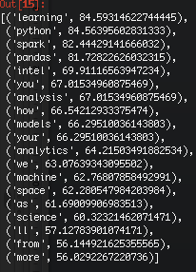
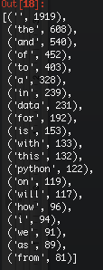
TF*IDF
TF

Slide 50
Parts of Speech
How about using POS tags?
Nouns
Verbs
Adjectives
Adverbs
Prepositions

Slide 51
Automatic Taggers
Almost all the POS taggers use the Penn-Treebank list of tags
https://www.ling.upenn.edu/courses/Fall_2003/ling001/penn_treebank_pos.html

Slide 52
Automatic Taggers
Almost all the POS taggers use the Penn-Treebank list of tags
https://www.ling.upenn.edu/courses/Fall_2003/ling001/penn_treebank_pos.html
Nouns : NN, NNS, NNP, NNPS
Verbs: VB, VBD, VBG, VBN, VBP, VBZ
Adjectives: JJ, JJR, JJS
Adverbs: RB, RBR, RBS
Prepositions: IN

Slide 53
How Are POS tags Effective?
Selected words based on POS Tag = Noun
We get candidates:
code.org
students
computer
science

Slide 54
How Are POS tags Effective?
Selected words based on POS Tag = Noun
We get candidates:
code.org
students
computer
science
We can post-process “Computer” and “Science”
to the Compound Nominal:
“Computer Science”

Slide 55
POS Tagging and Parsing
Stanford Core NLP
http://nlp.stanford.edu:8080/corenlp/
NLTK
Natural Language Toolkit
You need to provide your own training data, and train models for NLTK to be effective

Slide 56
Other Linguistic Features of Interest
The goal of both stemming and lemmatization is to reduce inflectional forms and sometimes derivationally related forms of a word to a common base form. E.g.
am, are, is → be
car, cars, car’s → car
Two approaches:
Stemming
Lemmatization

Slide 57
Stemming and Lemmatization
Stemming
crude heuristic process
chops off the ends of words
hope of achieving this goal
Lemmatization
use of a vocabulary
morphological analysis of words
returns the base or dictionary form of a word
base form is known as the lemma

Slide 58
Experiments with NPs
Using NP’s only
Do you expect results to improve?

Slide 59
Recap
Tokenization (word tokens) + data cleanup
Word Frequencies
Word Vectors
TF*IDF
POS tags
Lemmatization/Stemming

Slide 60
You JUST Did some
Information Extraction
From text!

Slide 61
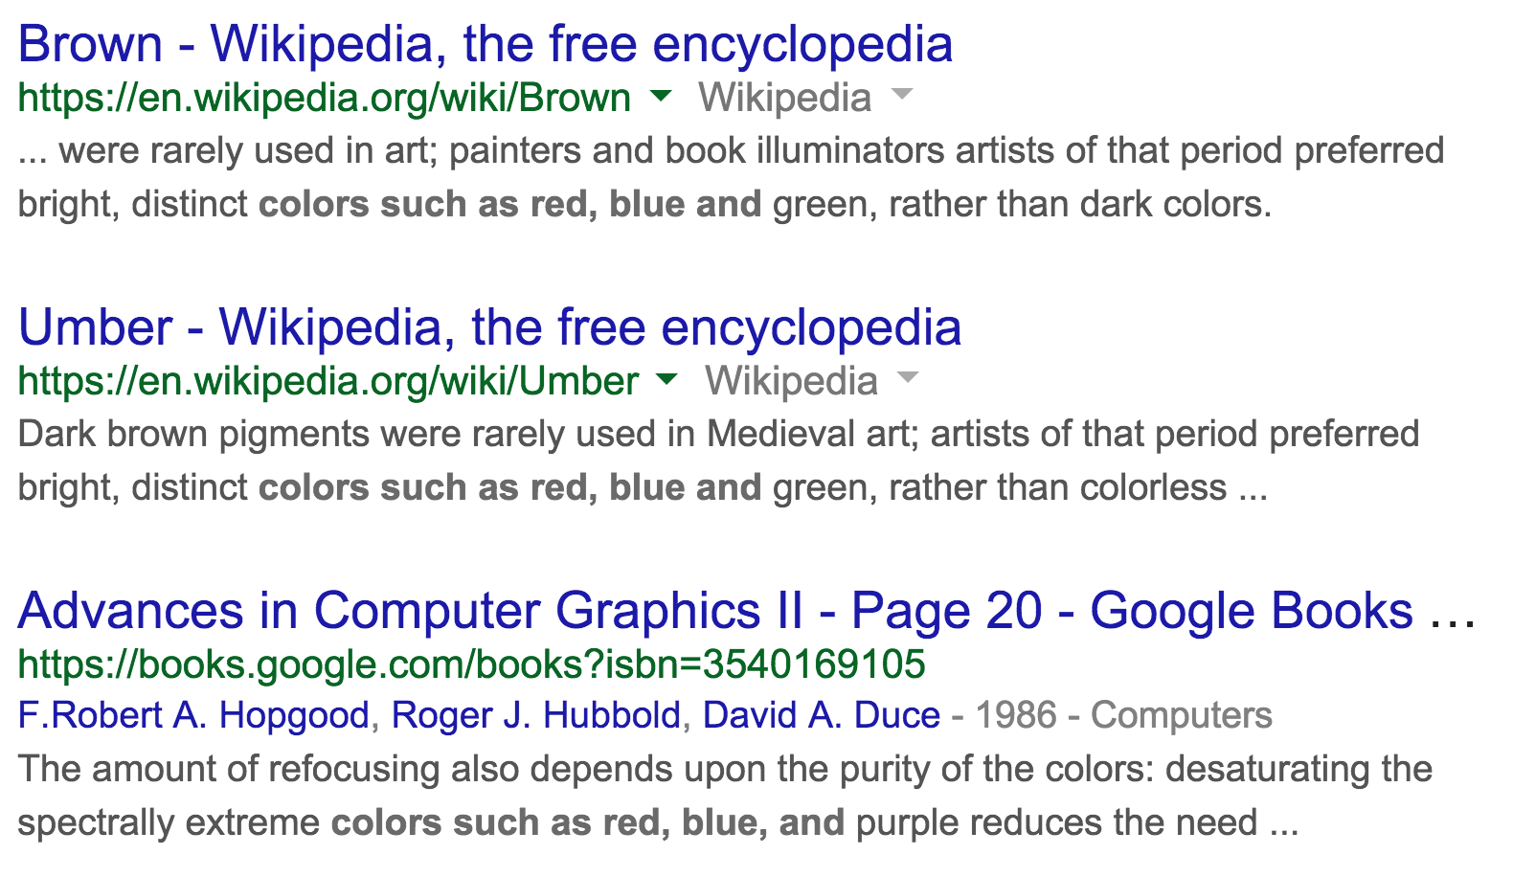
Other ways for IE
colors such as red, blue and …

Slide 62
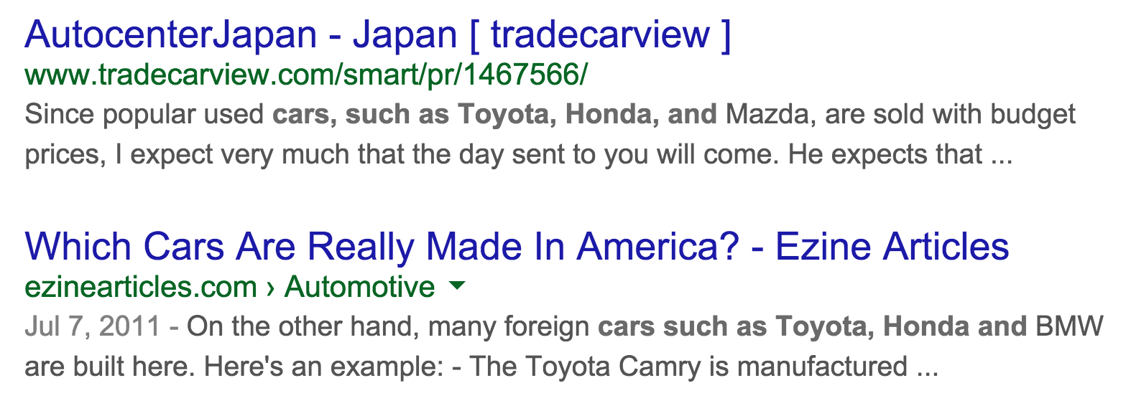
Other ways for IE
cars such as toyota, honda and ?

Slide 63
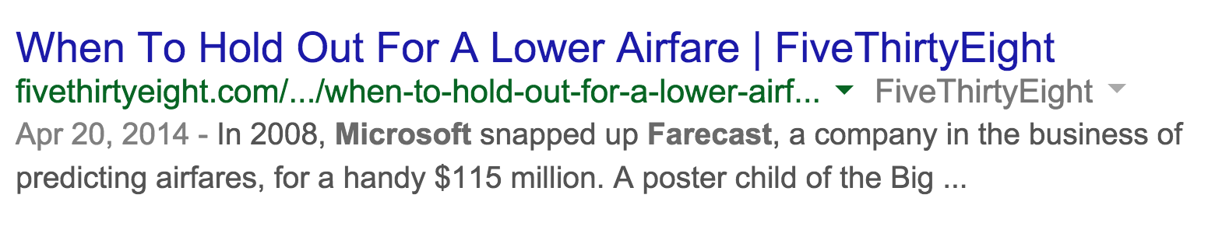
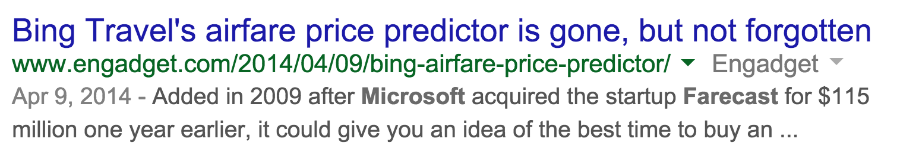
Other ways for IE
Find different relations between 2 concepts:
Microsoft bought Farecast

Slide 64
Outline
Information Extraction: Extract key phrases and concepts from unstructured text
Information Retrieval: search
Deep Learning: Converting words to semantic vectors

Slide 65

Very Cool!
..one more thing..

Slide 66
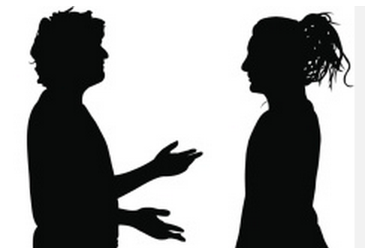
When I type in this term, can you show me all the talks about it?
It will probably take you several weeks!
We should leave you alone..

Slide 67
Thoughts and Strategies?
Suggestions?
something based on TF*IDF
Cosine Similarity
J. Index
Bag of words
Audience Participation

Slide 68
FAIRY GODMOTHER SAYS
Fancy algorithms will help you build products rapidly, but you need to know how they work to apply them well
INFORMATION RETRIEVAL
Vector Space model using TF*IDF

Slide 69
Information Retrieval Basics
Create a vector for each of the pages
Find the similarity between the input phrase and the pages
The page with the highest similarity wins!
d₁ | 1 | 0 | 0 | 6 | 8 | 6 | 7 | 2 | 5
d₂ | 0 | 7 | 3 | 1 | 5 | 3 | 0 | 0 | 0
phr | 0 | 7 | 3 | 7 | 5 | 8 | 0 | 0 | 0

Slide 70
Vector Space Model
Large Sparse vectors of words in a page
Each index in the vector represents a word
The value of each index is the TF*IDF of that word
 | a | ant | car | bug | .. | .. | .. | .. | ..
d₁ | 1 | 0 | 0 | 6 | 8 | 6 | 7 | 2 | 5

Slide 71
Dot Product
Quantifies the similarity between two documents
Similarity = cosine similarity of their vector representations V_{d1} and V_{d2}
It compensates for the effect of document length

Slide 72
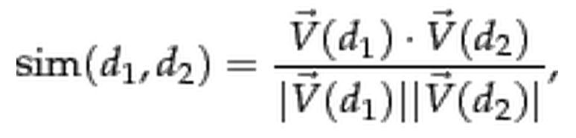
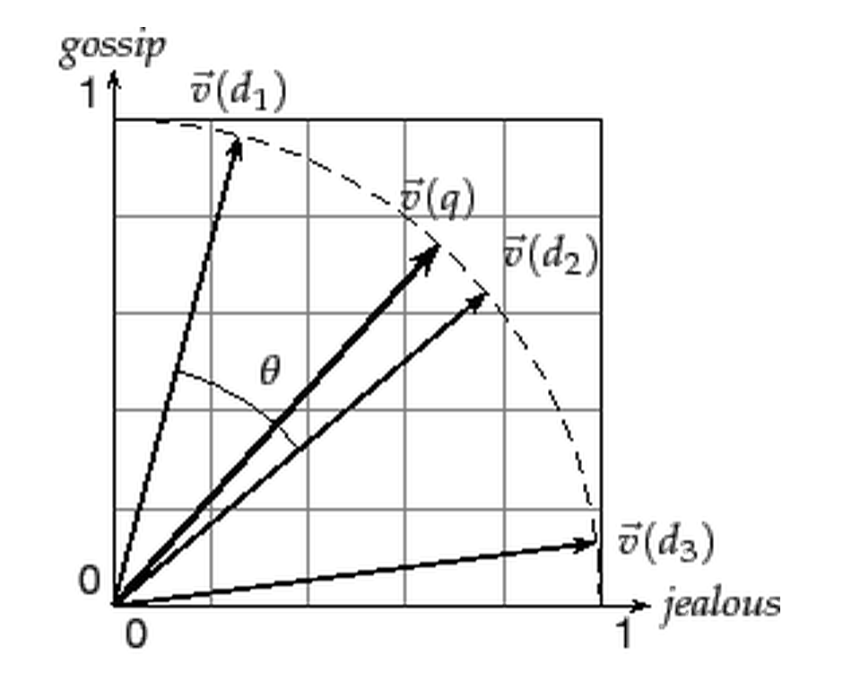
Dot Product

Slide 73
Intuition
Convert each document into a vector
If a word exists in the document, set its value as the TF*IDF score of the word in the document
If the word does not exist in the document, set its value as zero
data | python | nlp | theano | rnn | apple | banana | cup | elephant | tea

Slide 74
Intuition
Consider 3 vectors:
Which vector is most similar to vector 1?
1 | data | python | nlp | theano | rnn | apple | banana | cup | elephant | tea
 | 1 | 1 | 1 | 1 | 0 | 0 | 0 | 0 | 0 | 0
2 | data | python | nlp | theano | rnn | apple | banana | cup | elephant | tea
 | 0 | 0 | 1 | 0 | 0 | 1 | 1 | 0 | 0 | 0
3 | data | python | nlp | theano | rnn | apple | banana | cup | elephant | tea
 | 1 | 1 | 1 | 1 | 0 | 1 | 1 | 0 | 0 | 0

Slide 75
Intuition
Computing similarity between V₁ and V₃:
1 | data | python | nlp | theano | rnn | apple | banana | cup | elephant | tea
 | 1 | 1 | 1 | 1 | 0 | 0 | 0 | 0 | 0 | 0
2 | data | python | nlp | theano | rnn | apple | banana | cup | elephant | tea
 | 0 | 0 | 1 | 0 | 0 | 1 | 1 | 0 | 0 | 0

Slide 76
Intuition
Computing similarity between V₁ and V₂:
1 | data | python | nlp | theano | rnn | apple | banana | cup | elephant | tea
 | 1 | 1 | 1 | 1 | 0 | 0 | 0 | 0 | 0 | 0
2 | data | python | nlp | theano | rnn | apple | banana | cup | elephant | tea
 | 0 | 0 | 1 | 0 | 0 | 1 | 1 | 0 | 0 | 0
Numerator:
(1*0) + (1*0) + (1*1) + (1*0) + (0*0) + (0*1) + (0*1) + (0*0) + (0*0) + (0*0) = 1
Denominator:
sqrt(1²+1²+1²+1²) * sqrt(1²+1²+1²) = 3.46
Similarity:
1/3.46 = 0.289

Slide 77
Intuition
Computing similarity between V₁ and V₃:
1 | data | python | nlp | theano | rnn | apple | banana | cup | elephant | tea
 | 1 | 1 | 1 | 1 | 0 | 0 | 0 | 0 | 0 | 0
3 | data | python | nlp | theano | rnn | apple | banana | cup | elephant | tea
 | 1 | 1 | 1 | 1 | 0 | 1 | 1 | 0 | 0 | 0
Numerator:
(1*1) + (1*1) + (1*1) + (1*1) + (0*0) + (0*1) + (0*1) + (0*0) + (0*0) + (0*0) = 4
Denominator:
sqrt(1²+1²+1²+1²) * sqrt(1²+1²+1²+1²+1²+1²) = 4.89
Similarity:
4/4.89 = 0.8179

Slide 78
Intuition
Consider 3 vectors:
Numbers tell us that V₁ is most similar to V₃
1 | data | python | nlp | theano | rnn | apple | banana | cup | elephant | tea
 | 1 | 1 | 1 | 1 | 0 | 0 | 0 | 0 | 0 | 0
2 | data | python | nlp | theano | rnn | apple | banana | cup | elephant | tea
 | 0 | 0 | 1 | 0 | 0 | 1 | 1 | 0 | 0 | 0
3 | data | python | nlp | theano | rnn | apple | banana | cup | elephant | tea
 | 1 | 1 | 1 | 1 | 0 | 1 | 1 | 0 | 0 | 0

Slide 79
Experiments With Search
Functions:
nlp_tools.build_search_model(<filename>)
nlp_tools.search(<phrase>)
nlp_tools.similarity(vector1, vector2)

Slide 80
Findings
Suggestions?
Audience Participation

Slide 81
You JUST Did some
Information Retrieval
From text!

Slide 82
Outline
Information Extraction: Extract key phrases and concepts from unstructured text
Information Retrieval: search
Deep Learning: Converting words to semantic vectors

Slide 83

WHOA!
This is awesome!

Slide 84

I need to learn more NLP technologies… FAST! What is new in NLP?

Slide 85
WORD2VEC
What if you can create this big model, that knows meaning?
That you can also objectively compute:
King – Man + Woman = Queen
You can find how the keywords are related

Slide 86
Word2Vec
The word2vec tool takes a text corpus as input and produces the word vectors as output.

Slide 87
Word2Vec
The word2vec tool takes a text corpus as input and produces the word vectors as output.
A simple way to investigate the learned representations is to find the closest words for a user-specified word.

Slide 88
Keywords Similar to France
Word | Cosine distance
spain | 0.678515
belgium | 0.665923
netherlands | 0.652428
italy | 0.633130
switzerland | 0.622323
luxembourg | 0.610033
portugal | 0.577154
russia | 0.571507
germany | 0.563291
catalonia | 0.534176

Slide 89
Intuition Behind Word2Vec
Two Models:
CBOW: Predicting probability of context given target word
Skip Gram: Predicting probability of target word given context

Slide 90
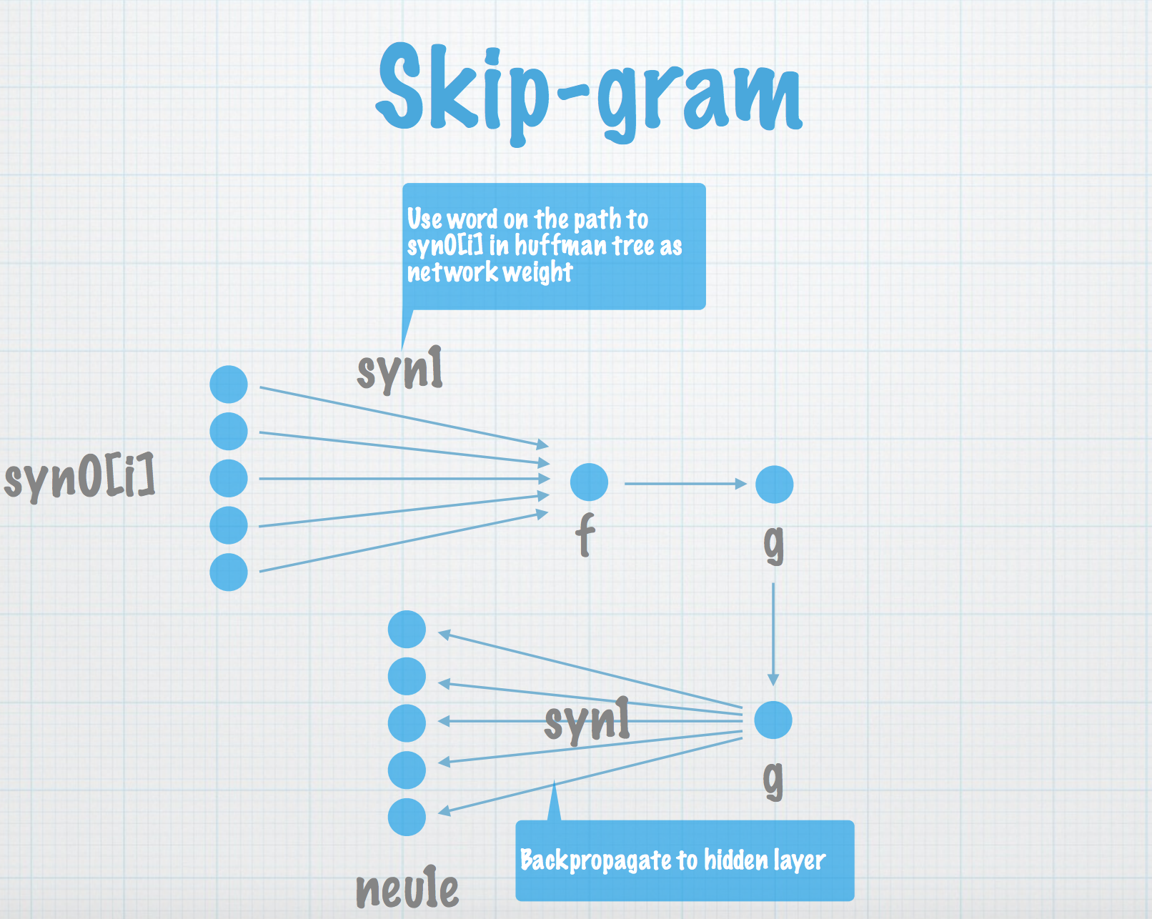
Skip Gram Model
Slides by Kai Sasaki

Slide 91
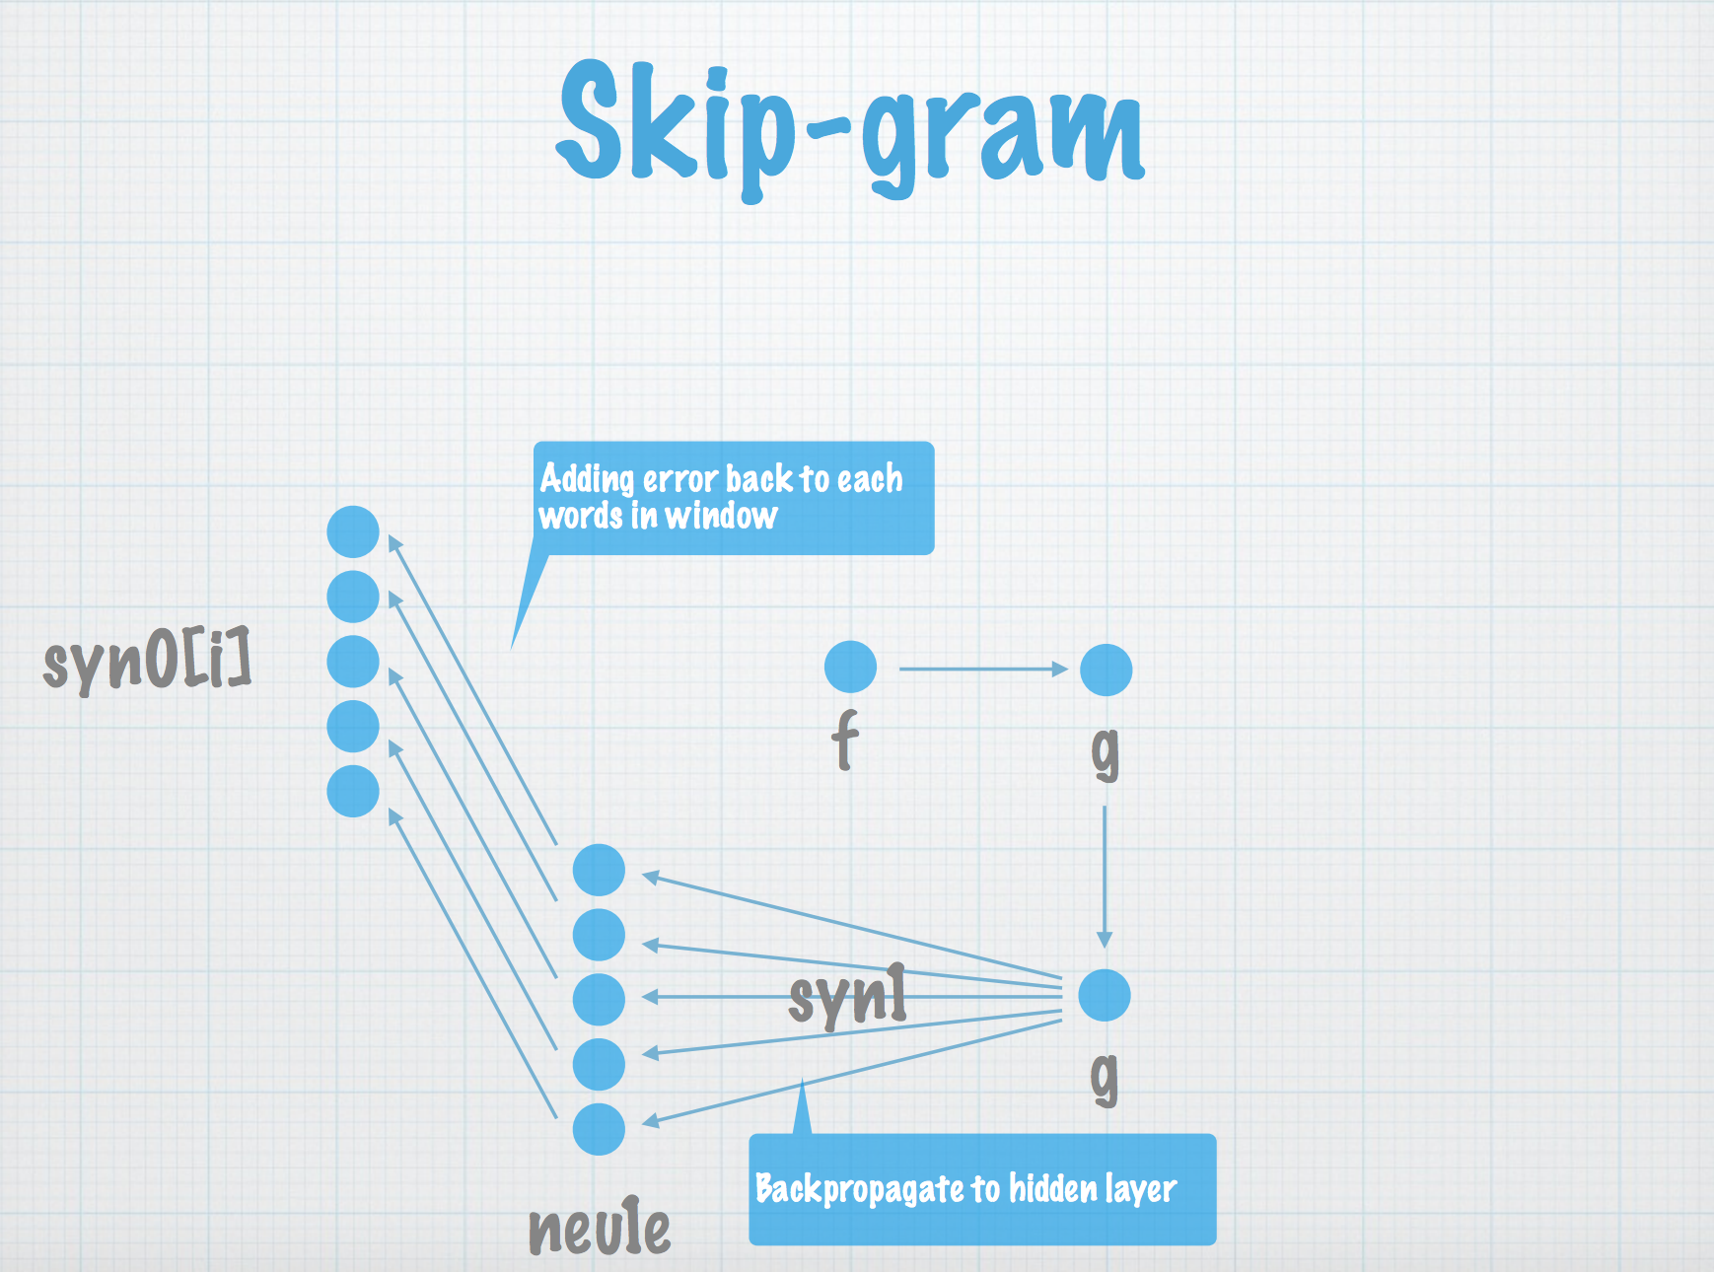
Slides by Kai Sasaki

Slide 92
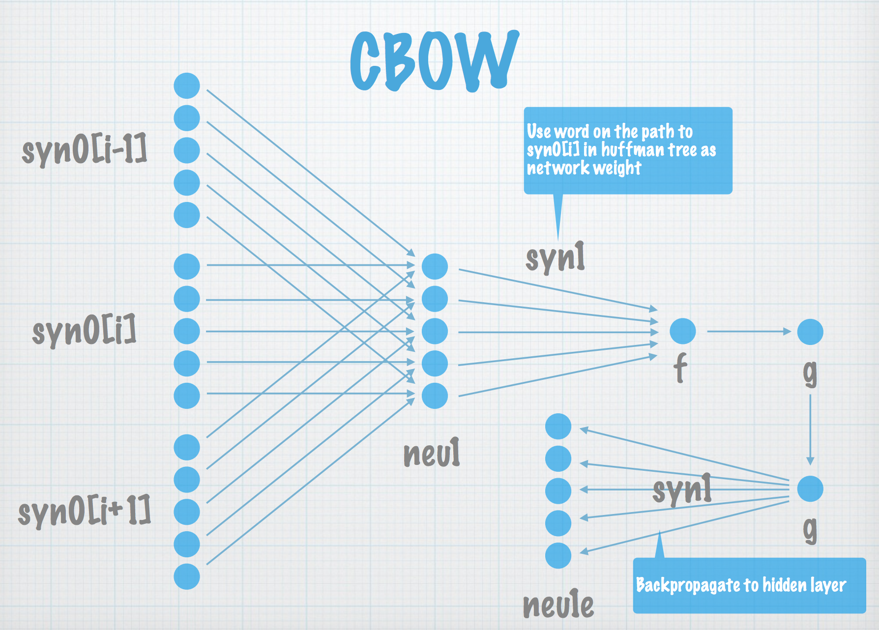
CBOW Model
Slides by Kai Sasaki

Slide 93
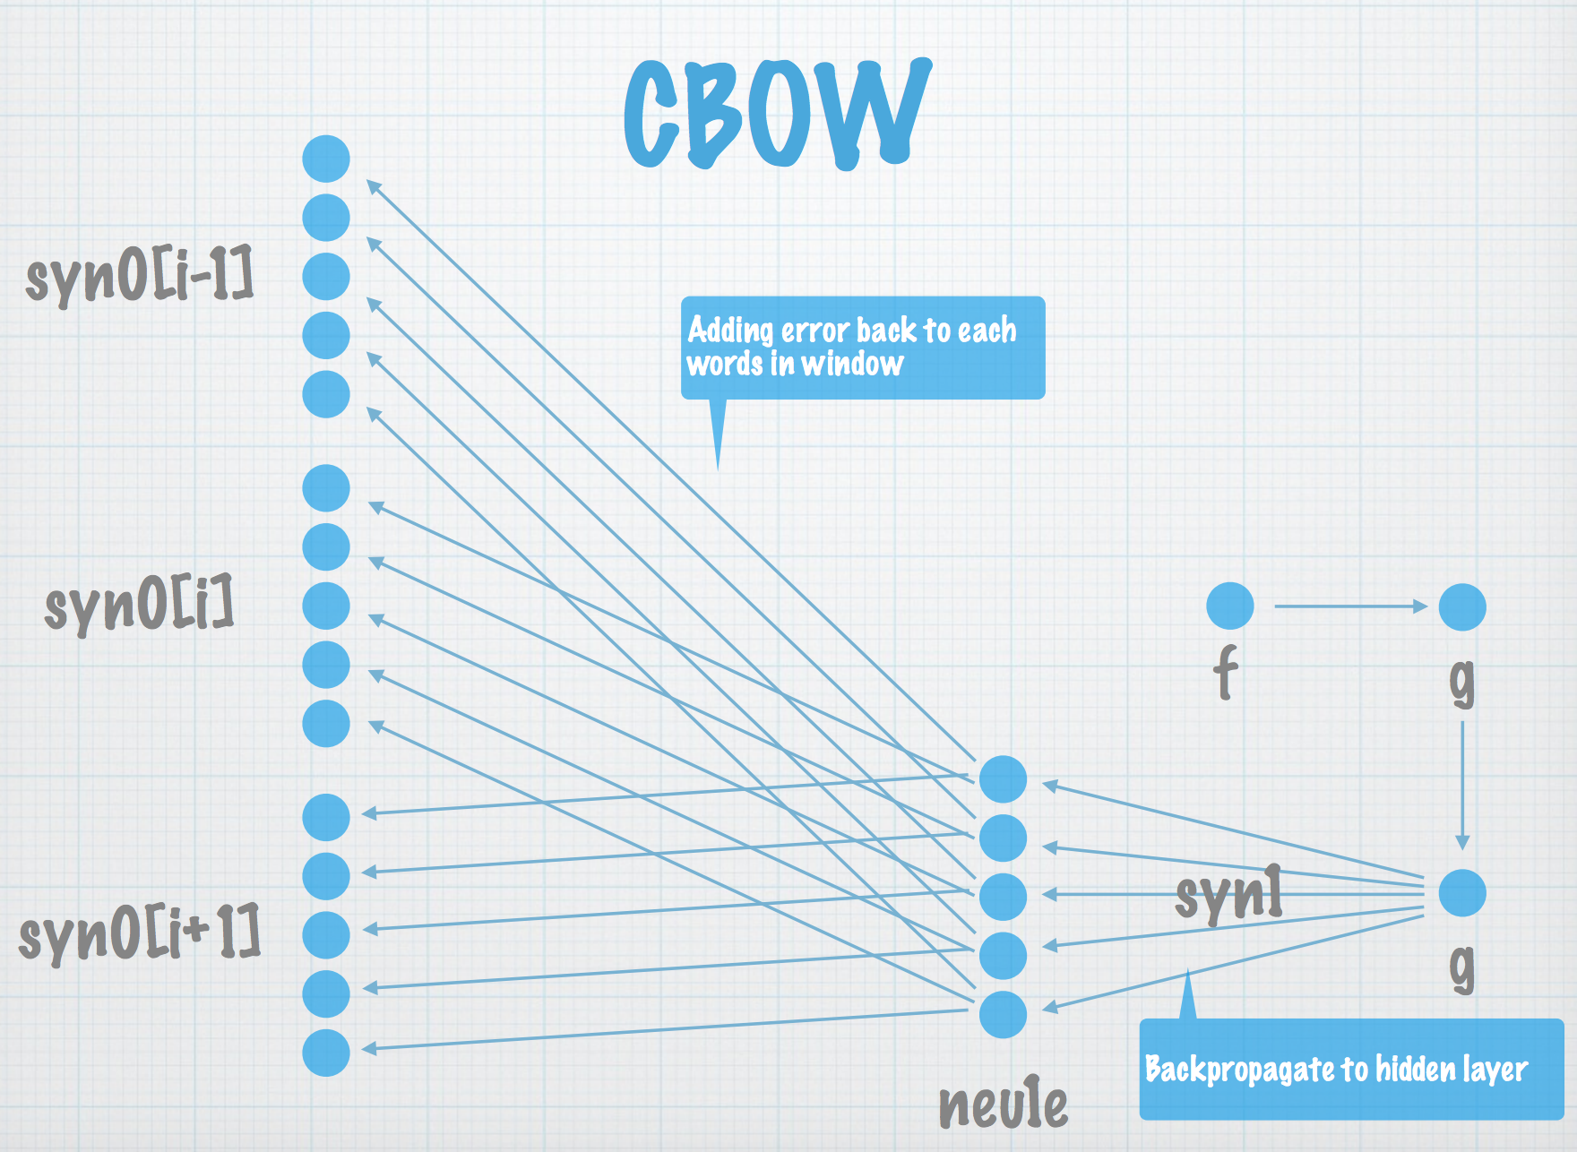
Slides by Kai Sasaki

Slide 94
Word2Vec Demo
How to run the demo at your end?
Online Word2Vec demo

Slide 95
Experiments With Word2Vec
Download and install gensim
Train a model

Slide 96
Outline
Information Extraction: Extract key phrases and concepts from unstructured text
Information Retrieval: search
Deep Learning: Converting words to semantic vectors

Slide 97
Closing Remarks
You already know:
Information Extraction
Information Retrieval
Deep Learning ( Word2vec)
NLP is very intuitive
You need to know the answers to aim for, before applying any algorithms

Slide 98
Closing Remarks
If you have any questions, please get in touch with me:
email : me@rutumulkar.com
twitter : @rutumulkar

Slide 99
Thank you For Listening!
Hope you Enjoyed Learning about NLP

